Slide 1
New COVID-19 Relief Bill & Round Two of PPP Loans
March 1, 2021
3:00 PM
Ruberto, Israel & Weiner, P.C.
Cambridge Savings Bank

Slide 2
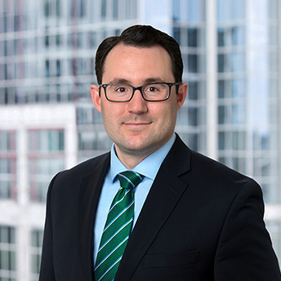
Michael J. Barone, Jr., Esq.
Associate Attorney
Ruberto, Israel & Weiner, P.C.
Office: 617-742-4200
Direct: 617-570-3511
mjb@riw.com

Slide 3
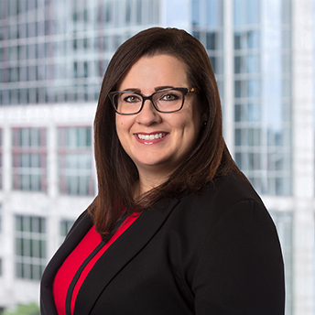
Bethany A. Grazio, Esq.
Shareholder
Ruberto, Israel & Weiner, P.C.
Office: 617-742-4200
Direct: 617-570-3572
bag@riw.com

Slide 4
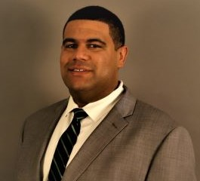
Adam D. Bispham, MBA
Vice President, Corporate Banking Loan Officer
Cambridge Savings Bank
Office: 617-441-4293
Direct: 857-998-3141
abispham@cambridgesavings.com

Slide 5
Economic Aid to Hard-Hit Small Businesses, Nonprofits, and Venues Act
Extended Loan Maturity
Extended Loan Deferral
Expanded Loan Forgiveness
EIDL advances no longer deducted from Loan Forgiveness
Established Shuttered Venue Operator Grant Program
Permitted Borrowers Receiving Loan Forgiveness to Delay Payment of Employment & Payroll Taxes

Slide 6
Biden-Harris Proposals
Expanded Equitable Relief*
Applicants between Feb. 24, 2021 and Mar. 9, 2021 limited to businesses with 20 or less employees
Elimination of one-year look back for non-fraud felony restrictions (unless applicant/owner incarcerated at time of application)
Elimination of student loan delinquency restriction
Permits Individual Tax Identification Number (ITIN) holders to apply and receive PPP loans
*Announced February 22, 2021

Slide 7
Major Modifications
PPP Revisions
New Loan Forgiveness Covered Period
The period beginning on the date of disbursement and ending any time between 8 and 24 weeks after funding (Borrower’s discretion)
Expanded Entity Eligibility
Borrowers that were previously prohibited by SBA rules are now permitted to apply for forgivable loans
Expanded Eligible Expenses
Addition of COVID related expenses that qualify for loan forgiveness
Maximum Loan Amount / One-Time Additional Disbursements
Revised calculation / recalculation of loan amounts for certain borrowers
Second Draw Loans
New round of loans available to existing PPP borrowers

Slide 8
Consolidated First Draw Loan Program
Expanded Eligibility
Non-Profit Businesses
Veteran Organizations
Tribal Businesses
Housing Cooperatives*
501(c)(6) entities*
News Organizations (NAICS)
Non-Profit Broadcasting Entity
Destination Marketing Orgs*
Orgs. engaged in legal gambling
Orgs. principally engaged in teaching/instructing/counseling/ indoctrinating religion/belief
*Limited to 300 employees.
Expanded Ineligibility
Entities Engaged in Illegal Activity
Household Employers
Hedge Funds/Private Equity Firms
Shuttered Venue Operators
Permanently Closed Businesses
Political and Lobbying Entities
Entities tied to China / Hong Kong
Entities not existing as of 2/15/20
Entities with delinquent or defaulted federal agency loans
Entities controlled by POTUS, VP, cabinet secretary, or any member of congress (or spouses)

Slide 9
First Draw Program Cont.
Expanded Forgivable Expenses
Operation Expenditures
Software and HR/accounting needs to permit continued operations
Property Damage Costs
Related to public disturbances occurring during 2020 that are not otherwise covered by insurance or other compensation
Supplier Costs
Funds spent on goods essential to operations and/or goods purchased as part of a contract, order, or purchase order
Worker Protection Expenditures
Capital expenditures (e.g., purchase / maintenance / renovation of assets)
Operating expenditures (e.g., personal protective equipment)

Slide 10
First Draw Program Cont.
Loan Increases and Disbursements
New Calculations
Seasonal Employers and Farmers/Ranchers
One-Time Additional Disbursements
Partner Compensation
Seasonal Employer
Reapplication & Request for Increases
Borrower that previously returned all of PPP loan
Borrower that previously returned part of PPP loan
Borrower that did not accept full amount of PPP loan

Slide 11
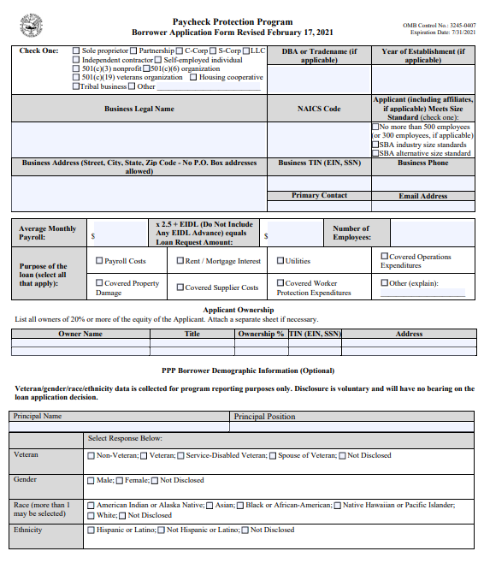
First Draw Application
SBA Form 2483
Rev. PPP Loan Application
Selectable Applicant Size
Expands permitted expenses
Incorporates demographics
Adds franchise question
Adds new certifications

Slide 12
First Draw Application Cont.
New Certifications
Applicant has not and will not receive another loan under the PPP (excluding Second Draw Loan)
Applicant has not and will not receive a Shuttered Venue Operator grant
POTUS, VPOTUS, the head of an Executive department, or Congress member (or spouse), does not directly or indirectly hold a controlling interest in the Applicant
Applicant is not an issuer of securities listed on a national securities exchange

Slide 13
Second Draw Loan Program
Eligibility
Small businesses having previously received a PPP loan; and
Has used all loan proceeds from first PPP Loan (or will use before Second Draw loan funds); and
Employs 300 or Less Employees (subject to NAICS 72 exception); and
Demonstrate at least a 25% reduction in gross receipts for any quarter of 2020 compared to the same quarter 2019 (or 25% reduction in annual receipts for 2020 compared to 2019, so long as borrower is in business in all quarters of 2019)
Ineligible Applicants
Entity ineligible for First Draw Loan
Political and Lobbying Entities
Entities tied to China / Hong Kong
Entity required to register under the Foreign Agent Registration Act
Shuttered Venue Operator
Entities controlled by POTUS, VP, cabinet secretary, or any member of congress (or spouses)
Issuer of securities listed on a national securities exchange
Entities having already received a Second Draw Loan
Permanently closed entity

Slide 14
Second Draw Program Cont.
Loan Details
General
5 year term at 1% per annum
100% guaranteed by the SBA with no collateral from borrower
Loan Amounts
2.5 times average monthly payroll
3.5 times average monthly payroll for entities in the Accommodation and Food Service industry (NAICS code 72)
$2 Million maximum loan
$4 Million maximum aggregate loan for any single corporate group
Eligible Expenses Qualifying for Forgiveness
Same as Consolidated First Draw Program
Employee and Wage Maintenance
Must meet same employee/wage criteria as First Draw Loan

Slide 15
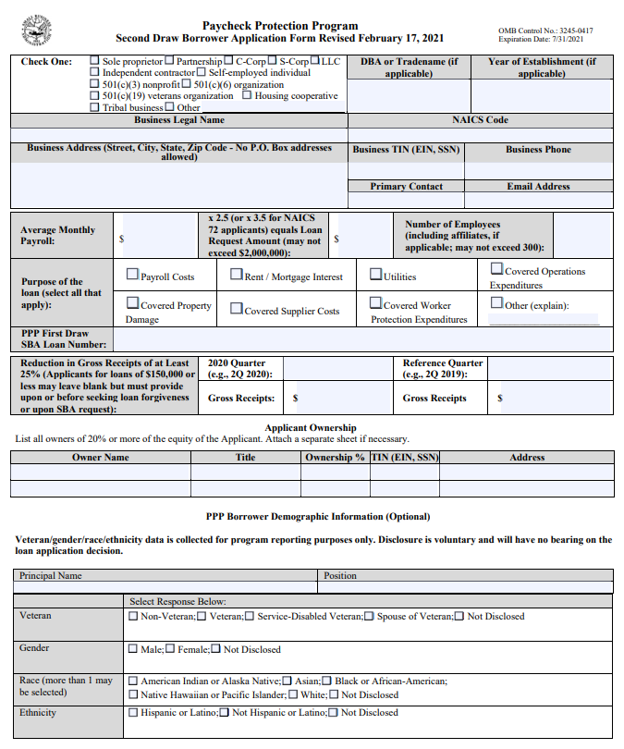
Second Draw Application
SBA Form 2483-SD
Rev. PPP Loan Application
3.5x factor for NAICS 72 orgs
Must list first PPP Loan No.
Reduction in Gross Receipts
15 Certifications

Slide 16
Forgiveness Applications
Form 3508 – Long Form Application
Full form requiring Borrowers to break down expenses, employee retention, and hour retention.
Form 3508-EZ – “Easy” Application
Simplified form for Borrowers that can make certain certifications relative to eligible expenses, maintenance of employees/wages, and operations.
Form 3508-S – Short Form Application
Form for Borrowers with loans under $150K that can certify compliance with all rules and guidance.

Slide 17
Practical Considerations Before Applying
Am I eligible? Are my expenses eligible?
Is this the right loan for my business?
Do I plan on seeking forgiveness?
What do the next 6-12 months look like?
What bank should I apply through?
Do I have all the appropriate paperwork?

Slide 18
Practical Considerations When Applying
Documents
Bank Account Number
Authorized Signers
EIN / TIN / ITIN
Business Documents
Payroll Tax Reports
Eligible Expense Docs
Advisors to Contact:
Accountant
Banker
Attorney
Insurance Agent

Slide 19
Reference Materials
Treasury Dept. PPP & EIDL
IFR – PPP as amended by Economic Aid Act
IFR – PPP Second Draw Loan Program
App – Rev. PPP Loan Application
App – Second Draw Loan Application
App – Forgiveness Application (Form 3508)
App – Forgiveness Application (Form 3508EZ)
App – Forgiveness Application (Form 3508S)
SOP – SBA SOP 50 10 6 (Effective 10-1-2020)

Slide 20
Questions and Answers

